Slide 1
Data Analyst Certification practical presentation

Slide 2
Background
Pens and Printers is a quality company that sells office products to other companies. Recently they launched a new line of office stationery and deployed 3 sales strategies:
Email
Call
Email and Call
In this presentation I will cover
How many customers were there for each approach?
What does the spread of the revenue look like overall? And for each method?
Was there any difference in revenue over time for each of the methods?
Recommendations and metric to track

Slide 3

Data Cleaning and preparation

Slide 4
Before any analysis could be done all columns of the dataset needed to be cleaned.
In brief the following steps were taken for each column
Format of the columns (i.e. numeric, character, factor, etc) were confirmed to be correct and consistent. Any columns in the improper format were converted.
Character columns were checked for any missing values, inconsistent nomenclature or capitalization, and proper spelling. Any inconsistencies were fixed. There were no missing values for any character columns
Numeric columns were checked for any missing values, negative values, or impossible values
The two customers that had a years as customer value of over 41 were removed from the dataset
There were 1074 missing values in the revenue column. These missing values were replaced with their respective sales method median to allow for a more complete analysis

Slide 5

Analysis

Slide 6
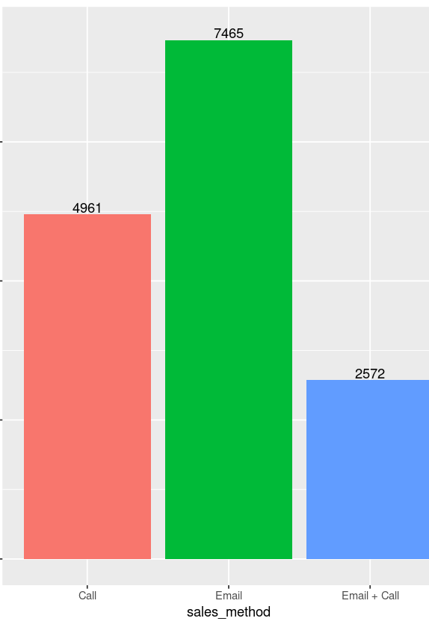
1. Number of customers

Slide 7
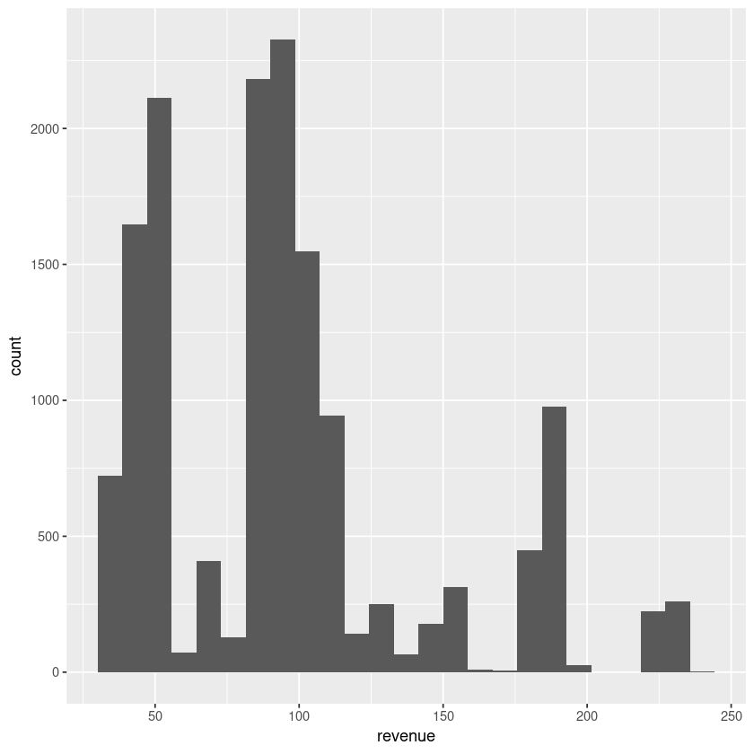
Overall Revenue distribution
Looking at the histogram we can see that this data is not evenly distributed, and the majority of data is on the left-hand side.

Slide 8
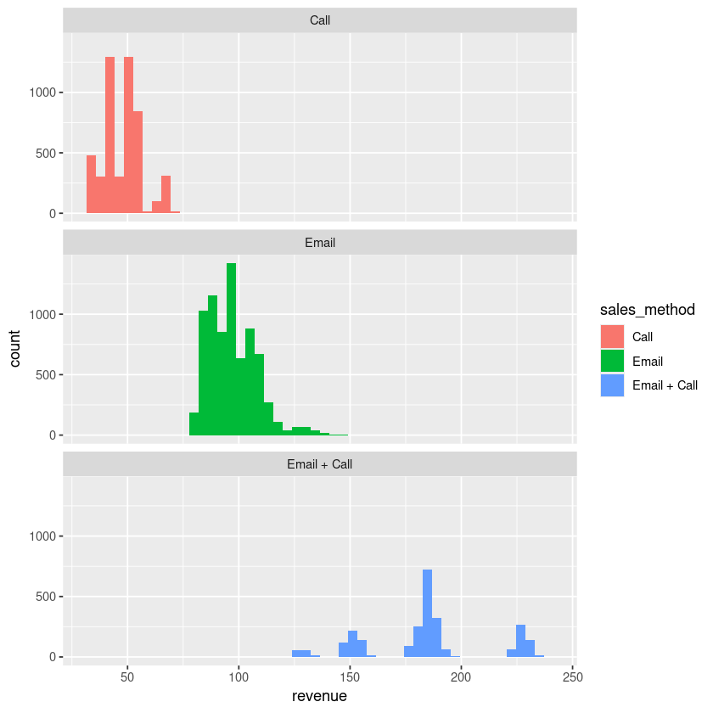
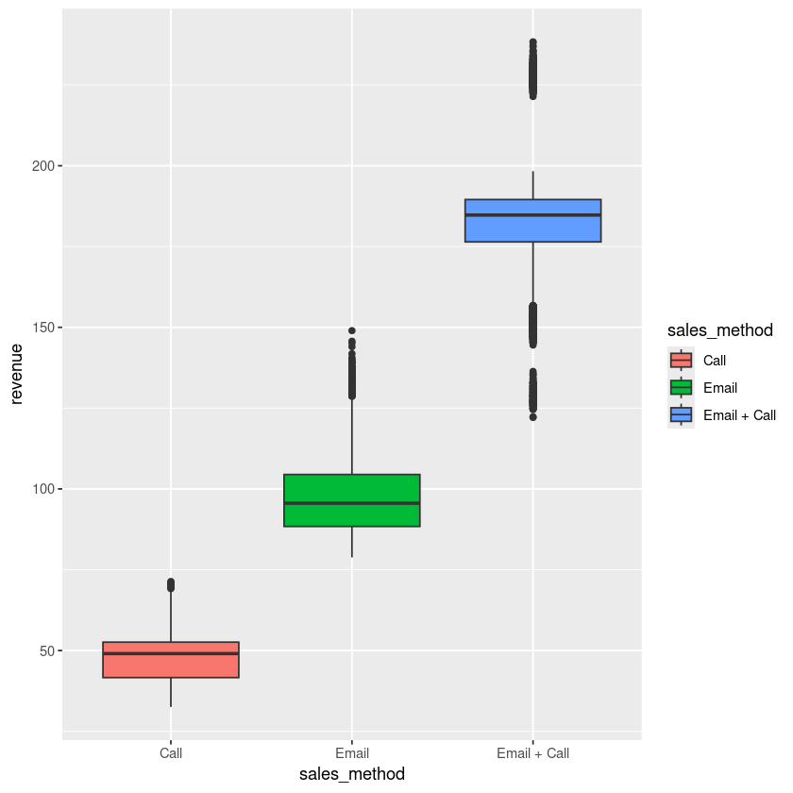
Revenue distribution by sales method
Both these graphs show that the distribution of revenue for the Email and Call group is widest, while the call group is narrowest.

Slide 9
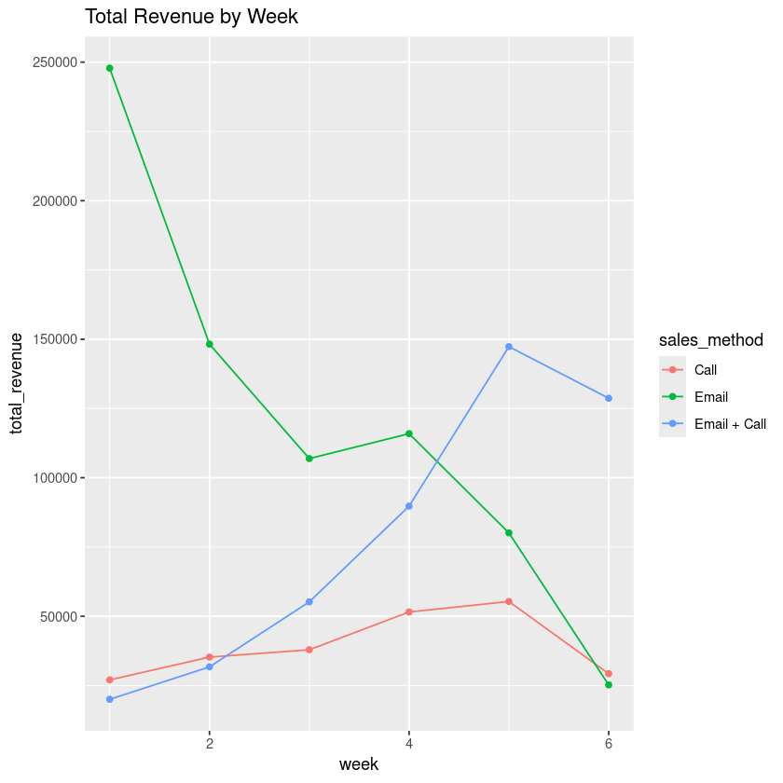
Revenue over time for each method

Slide 10
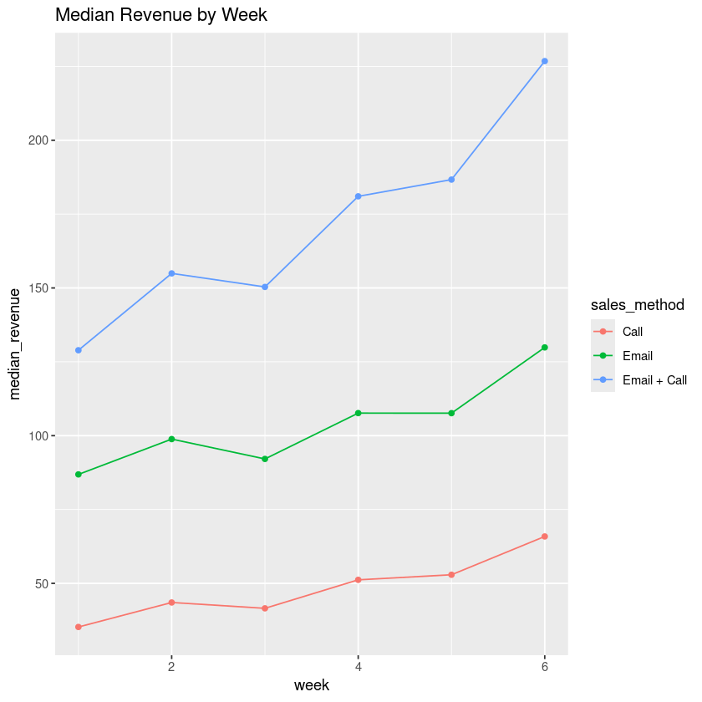
Metric to track
A good metric to track would be the median revenue generated each week. I chose this measure because it is more resistant to extremes and will allow for a true measure of what an average customer spends each week.
Based on the data from weeks 1-6 we can successfully predict that the median revenue for week 7 would be $83.82 for the calling method, 139.26 for the email method and 206.88 for the email and call method

Slide 11
Recommendations
Because the Email method takes less time than the Email and Call method, I did a hypothesis test to see if there was a significant difference in the total revenue. There was a significant difference between the two methods, therefore I recommend focusing on the Email and Call method in the future.
I also suggest doing a follow up call or email week 6 because there was a decrease in both number of items sold and revenue that week.
There was no correlation between number of site visits and number of items sold or revenue, so I suggest limiting the number of site visits unless there is another reason for them.
Data validity and completeness are essential for analysis. I recommend taking steps to ensure data is complete and accurate before doing any analysis

Slide 12
Thank you
Callie McDonough

